Slide 1
Relational Algebra
Rodica Neamtu
rneamtu@wpi.edu

Slide 2
Algebra Behind the Query Language
Relational Algebra
Set of operators that operate on relations
Operator semantics based on Set or Bag theory
Relational algebra form underlying basis (and optimization rules) for SQL
SELECT pNumber, count(*) AS CNT
FROM Student
WHERE sNumber > 1
GROUP BY pNumber;

Slide 3
Relational Algebra
Basic operators
  Set Operations (Union: ∪, Intersection: ∩ ,difference: – )
  Select: σ
  Project: π
  Cartesian product: x
  rename: ρ
More advanced operators, e.g., grouping and joins
The operators take one or two relations as input and produce a new relation as output
One input → unary operator, two inputs →binary operator

Slide 4
Relational Algebra
Similar in concept to arithmetic operators and expressions
In relational algebra, instead of variables we have relations
  (w + t) / ((x + y) * 3)
w, t, x, y are called variables
+, /, * are called binary operators
  π_{customer_name} (R ⋈ σ_{balance <100} (S) )
R, S are DB relations
Relational operators

Slide 5
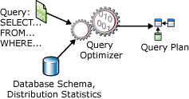
Why it is important
Query compilation, optimization, and execution rely on the relational algebra

Slide 6
Set Operators
Union, Intersection, Difference
Defined only for union compatible relations
Relations are union compatible iff
  they have same sets of attributes (schema), and
  the same types (domains) of attributes
Example : Union compatible or not?
  Student (sNumber, sName)
  Course (cNumber, cName)
Not compatible

Slide 7
Union over sets: ∪
Consider two relations R and S that are union-compatible
R
S
R  S
A | B
1 | 2
3 | 4
A | B
1 | 2
3 | 4
5 | 6
A | B
1 | 2
3 | 4
5 | 6

Slide 8
Difference over sets: –
R – S are the tuples that appear in R and not in S
Defined as:
  R – S = {t | t ∈R and t∈ S}
R
S
R – S
A | B
1 | 2
3 | 4
A | B
1 | 2
5 | 6
A | B
3 | 4

Slide 9
Intersection over sets: ∩
Consider two Relations R and S that are union-compatible
R
S
R ∩ S
A | B
1 | 2
3 | 4
A | B
1 | 2
3 | 4
5 | 6
A | B
1 | 2
3 | 4

Slide 10
Selection: σ
Select: σ_{c} (R):
  c is a condition on R’s attributes
  Select subset of tuples from R that satisfy selection condition c
R
σ_{(C ≥ 6)} (R)
A | B | C
1 | 2 | 5
3 | 4 | 6
1 | 2 | 7
A | B | C
3 | 4 | 6
1 | 2 | 7

Slide 11
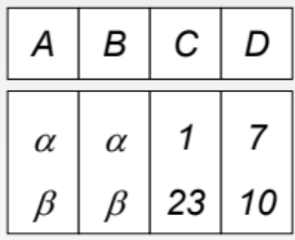
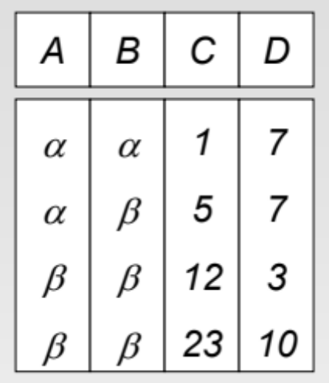
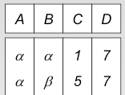
Selection: Example
σ _{((A=B) ^ (D>5))} (R)
R
σ _{(D > C)} (R)

Slide 12
Project: π
π_{A1, A2, …, An} (R), with A1, A2, …, An ∈ attributes A_{R}
  returns all tuples in R, but only columns A1, A2, …, An
A1, A2, …, An are called Projection List
R
π_{A, C} (R)
A | B | C
1 | 2 | 5
3 | 4 | 6
1 | 2 | 7
1 | 2 | 8
A | C
1 | 5
3 | 6
1 | 7
1 | 8

Slide 13
Extended Projection: π_{L} (R)
Example
Compute this expression and call it X
Rename column A to V
π _{C, V←A, X← C*3+B} (R)
R
A | B | C
1 | 2 | 5
3 | 4 | 6
1 | 2 | 7
1 | 2 | 8
C | V | X
5 | 1 | 17
6 | 3 | 22
7 | 1 | 23
8 | 1 | 26

Slide 14
Extended Projection: π_{L} (R)
Example
What If I want to select column B, and add another column called ‘Test’ containing word ‘Ok’
π _{B, ‘Ok’ As Test} (R)
R
A | B | C
1 | 2 | 5
3 | 4 | 6
1 | 2 | 7
1 | 2 | 8
B | Test
2 | Ok
4 | Ok
2 | Ok
2 | Ok

Slide 15
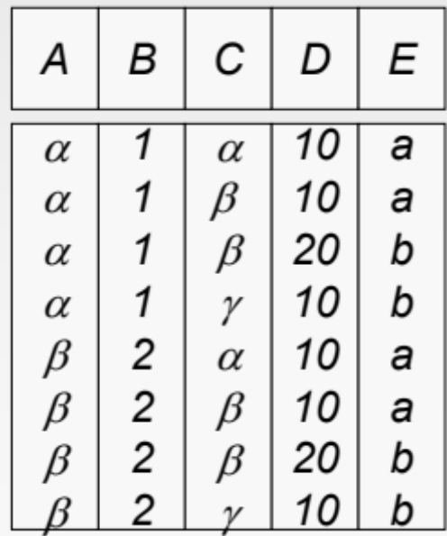
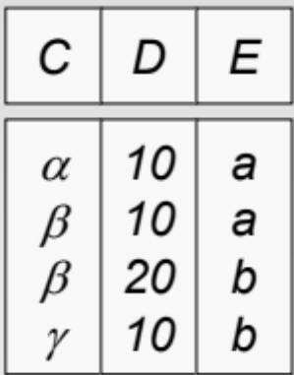
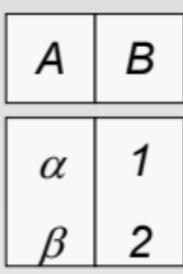
Cross Product (Cartesian Product): X
R X S
S
R

Slide 16
Renaming: ρ
ρ_{S} (R) changes relation name from R to S
ρ_{S(A1, A2, …, An)} (R) renames also attributes of R to A1, A2, …, An
ρ_{S} (R)
ρ_{S(B->X, C, D)} (R)
R
S
S
B | C | D
2 | 3 | 10
2 | 3 | 11
6 | 7 | 12
B | C | D
2 | 3 | 10
2 | 3 | 11
6 | 7 | 12
X | C | D
2 | 3 | 10
2 | 3 | 11
6 | 7 | 12

Slide 17
Composition of Operators
The true power is when you form expressions and put several operators together
We do the same with arithmetic operators
  (w + t) / ((x + y) * 3)

Slide 18
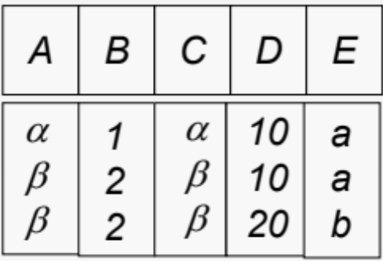
Composition of Operators
Can build expressions using multiple operations
Example: σ_{A=C}(R x S)
R X S
S
R
σ_{A=C}(R x S)

Slide 19
Banking Example
branch (branch_name, branch_city, assets)
customer (customer_name, customer_street, customer_city)
account (account_number, branch_name, balance)
loan (loan_number, branch_name, amount)
depositor (customer_name, account_number)
borrower (customer_name, loan_number)

Slide 20
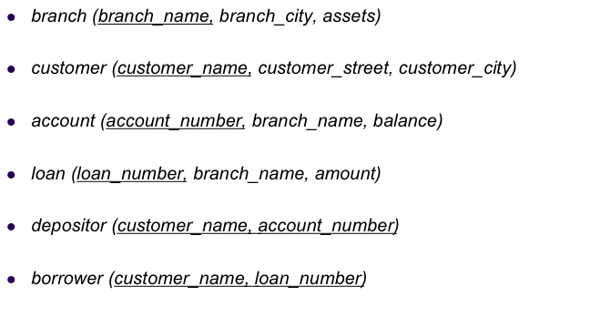

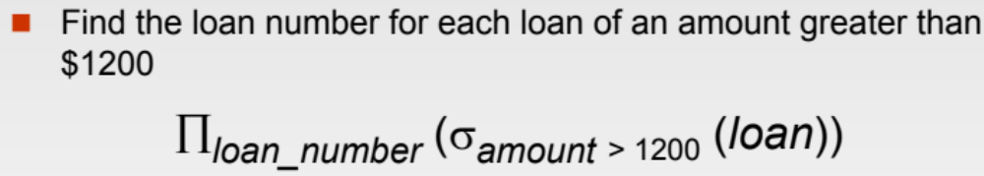
Example Queries

Slide 21

Example Queries (Cont’d)

Slide 22
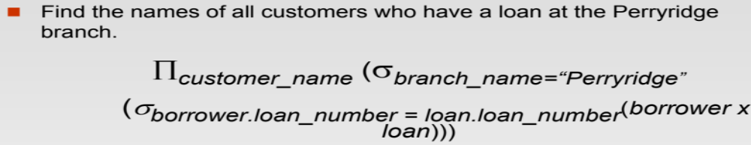
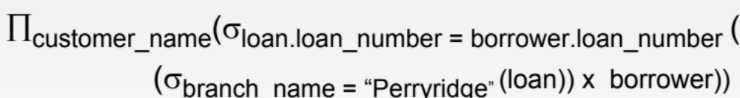
Example Queries (Cont’d)

Slide 23
Example Queries
Find customers’ names who have neither accounts nor loans
  π_{customer_name}(customer) -
  (π_{customer_name}(borrower) U π_{customer_name}(depositor))

Slide 24
Joins
We mentioned Cartesian Product multiplies two relations
R X S
S
R
What if I want to join R and S based on a certain condition?
  Natural and Theta Joins

Slide 25
Natural Join: R ⋈ S
(Join on the common attributes)
Consider relations
  R with attributes A_{R}, and
  S with attributes A_{S}.
Let A = A_{R} ∩ A_{S} = {A1, A2, …, An} The common attributes
In English
  Natural join R ⋈ S is a Cartesian Product R X S with equality predicates on the common attributes (Set A)

Slide 26
Natural Join: R ⋈ S
R ⋈ S can be defined as :
π_{AR – A, A, AS - A} (σ_{R.A1 = S.A1 AND R.A2 = S.A2}
_{AND … R.An = S.An}
(R X S))
Project the union of all attributes
Equality on common attributes
Cartesian Product
Common attributes appear once in the result

Slide 27
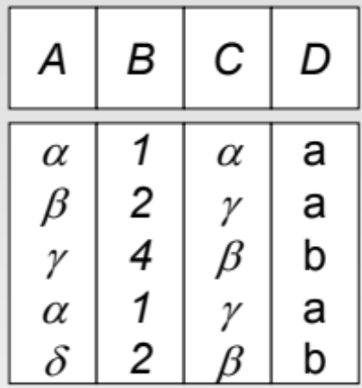
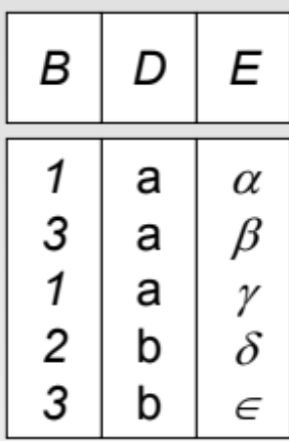
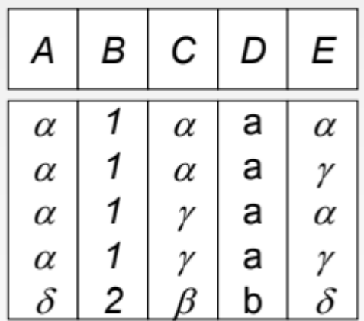
Natural Join: R ⋈ S: Example
Implicit condition
(R.B = S.B and R.D = S.D)
R
S
R ⋈ S

Slide 28
Theta Join: R ⋈_{C} S
Theta Join is cross product, with condition C
It is defined as :
R ⋈_{C} S = (σ_{C} (R X S))
Theta join can express both Cartesian Product & Natural Join
Recommendation:
Better to use Theta join
(more explicit and more clear)
R
S
A | B
1 | 2
3 | 2
D | C
2 | 3
4 | 5
4 | 5
R ⋈ _{R.A>=S.C}S
A | B | D | C
3 | 2 | 2 | 3

Slide 29
Example Queries
Find customer names having account balance below 100 or above 10,000
  π_{customer_name} (σbalance <100 OR balance > 10,000 (depositor ⋈ account) )

Slide 30
Assignment Operator: ←
The assignment operation (←) provides a convenient way to express complex queries on multiple lines
Write query as a sequence of lines consisting of:
  Series of assignments
  Result expression containing the final answer
Example:
  R1 ← (σ _{((A=B) ^ (D>5))} (R – S)) ∩ W
  R2 ← R1 ⋈_{(R.A = T.C)} T
  Result ← R1 U R2

Slide 31
Example Queries
For branches that gave loans > 100,000 or hold accounts with balances >50,000, report the branch name along with the information of whether it is reported because of a loan or an account
  R1 ← π_{branch_name, ‘Loan’ As Type} (σ_{amount >100,000} (loan))
  R2 ← π_{branch_name, ‘Account’ As Type}(σ_{balance > 50,000} (account)))
  Result ← R1 U R2

Slide 32
Example Queries
Find customers having account balance below 100 and loans above 10,000
  R1 ← π_{customer_name} (depositor ⋈ π_{account_number}(σ_{balance <100} (account)))
  R2 ← π_{customer_name} (borrower ⋈ π_{loan_number}(σ_{amount >10,000} (loan)))
  Result ← R1 ∩ R2

Slide 33
Duplicate Elimination: δ (R)
Delete all duplicate records
Convert a bag to a set
R
 (R)
A | B
1 | 2
3 | 4
1 | 2
1 | 2
A | B
1 | 2
3 | 4

Slide 34
More Relational Operators

Slide 35
Grouping & Aggregation operator: γ
Aggregation function takes a collection of values and returns a single value as a result
  avg: average value
  min: minimum value
  max: maximum value
  sum: sum of values
  count: number of values
Grouping & Aggregate operation in relational algebra
  γg1,g2, …gm, F1(A1), F2(A2), …Fn(An) (R)
  R is a relation or any relational-algebra expression
  g1, g2, …gm is a list of attributes on which to group (can be empty)
  Each Fi is an aggregate function applied on attribute Ai within each group

Slide 36
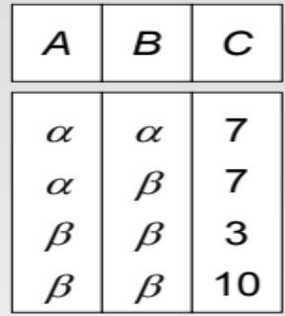
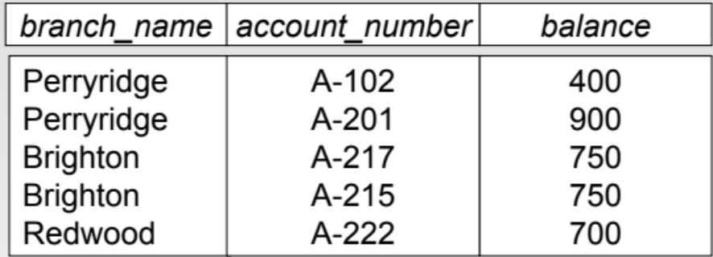
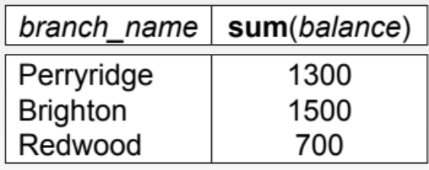
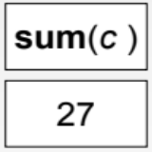
Grouping & Aggregation Operator: Example
R
S
  γ_{branch_name,sum(balance)}(S)
  γ_{sum(c)}(R)

Slide 37
Example Queries
Find customer names having loans with sum > 20,000
  π_{customer_name} (σ_{sum > 20,000} (γcustomer_name, sum ← sum(amount)(loan ⋈ borrower)))

Slide 38
Example Queries
Find the branch name with the largest number of accounts
  R1 ← γbranch_name, countAccounts ← count(account_number)(account)
  R2 ← γ_{Max ← max(countAccounts)}(R1)
  Result ← π_{branch_name}(R1 ⋈_{countAccounts = Max} R2)

Slide 39
Example Queries
Find account numbers and balances for customers having loans > 10,000
  π_{account_number, balance}
  ( (depositor ⋈ account) ⋈
  (π_{customer_name} (borrower ⋈ (σ_{amount >10,000} (loan))))
  )

Slide 40
Reversed Queries (what does it do)?
  π_{customer_name}(customer) - π_{customer_name}(borrower)
Find customers who did not take loans

Slide 41
Reversed Queries (what does it do)?
  R1 ← (γ_{MaxLoan ← max(amount)}(σ_{branch_name= “ABC”} (loan)))
  Result ← π_{customer_name}(borrower ⋈ (R1 ⋈MaxLoan=amount^branch_name= “ABC” loan))
Find customer name with the largest loan from a branch “ABC”

Slide 42
Relationships Among Operators (I)
Intersect as Difference
  R ∩ S = R– (R–S)
Join as Cartesian Product + Select
  R ⋈_{C} S = (σ_{C} (R X S))
Select is commutative
  σ_{C2} (σ_{C1} (R)) = σ_{C1} (σ_{C2} (R)) = σ_{C1^C2} (R)
Order between Select & Project
  σ_{C} (π_{list} (R)) → π_{list} (σ_{C} (R))
  π_{list} (σ_{C} (R)) → σ_{C} (π_{list} (R))
Only if “list” contains all columns needed by conditions C

Slide 43
Relationships Among Operators (II)
Join is commutative
  R ⋈_{C} S = S ⋈_{C} R
Order between Select & Join
  σ_{R.x=“5”} (R ⋈_{R.a = S.b} S ) → ((σ_{R.x=“5”} (R)) ⋈_{R.a = S.b} S)

Slide 44
Some Basic Rules for Algebraic Expressions
(For Better Performance)

Slide 45
1- Joins vs. Cartesian Product
Use Joins instead of Cartesian products (followed by selection)
  R ⋈_{C} S = (σ_{C} (R X S)) -- LHS is better
Intuition: There are efficient ways to do the L.H.S without going through the two-steps R.H.S
CS3431

Slide 46
2- Push Selection Down
Whenever possible, push the selection down
  Selection is executed as early as possible
Intuition: Selection reduces the size of the data
Examples
  σ_{C} (π_{list} (R)) → π_{list} (σ_{C} (R)) -- RHS is better
  σ_{R.x=“5”} (R ⋈_{R.a = S.b} S ) → ((σ_{R.x=“5”} (R)) ⋈_{R.a = S.b} S) -- RHS is better
CS3431

Slide 47
3- Avoid Un-necessary Joins
Intuition: Joins can dramatically increase the size of the data
Find customers having account balance below 100 and loans above 10,000
  R1 ← π_{customer_name} (depositor ⋈ π_{account_number}(σ_{balance <100} (account)))
  R2 ← π_{customer_name} (borrower ⋈ π_{loan_number}(σ_{amount >10,000} (loan)))
  Result ← R1 ∩ R2
Better than joining the 4 relations and then selecting

Slide 48
Operations On Bags

Slide 49
Relations may have duplicates
R(A, B)
π_{B} (R)
R
Under operations, the relation may become a bag
A | B
1 | 2
3 | 4
10 | 2
15 | 3
B
2
4
2
3
The base relation has a primary key, so all records are unique (Set)
This new relation is a bag
CS3431

Slide 50
Operations on Bags
Most DBMSs allow relations to be bags (not limited to sets)
All previous relational algebra operators apply to both sets and bags
  Bags allow duplicates
Duplicate elimination operator converts a bag into a set
Some properties may hold for sets but not bags
  Example: R U R = R (True for sets, False for bags)

Slide 51
Example Operations on Bags: Union: ∪
Consider two relations R and S that are union-compatible
R U S
R
S
A | B
1 | 2
1 | 2
1 | 2
3 | 4
3 | 4
5 | 6
A | B
1 | 2
3 | 4
1 | 2
A | B
1 | 2
3 | 4
5 | 6
Suppose a tuple t appears in R m times, and in S n times.
Then in the union, t appears m + n times.

Slide 52
Example Operations on Bags: Intersection: ∩
Consider two relations R and S that are union-compatible
R
S
R ∩ S
A | B
1 | 2
3 | 4
1 | 2
A | B
1 | 2
3 | 4
5 | 6
A | B
1 | 2
3 | 4
Suppose tuple t appears in R m times, and in S n times.
Then in intersection, t appears min (m, n) times.

Slide 53
Example Operations on Bags: Difference: –
R
S
R – S
A | B
1 | 2
3 | 4
1 | 2
A | B
1 | 2
3 | 4
5 | 6
A | B
1 | 2
Suppose tuple t appears in R m times & in S n times.
Then in R – S, t appears max (0, m - n) times.

